Slide 1
Diversity, Equity & Inclusion

Slide 2
Diversity Definition
Diversity is differences in racial and ethnic, socioeconomic, geographic, and academic/profession backgrounds. It encompasses people with different opinions, backgrounds (degrees/social experiences), religious beliefs, political beliefs, sexual orientations, heritage, and life experience.

Slide 3
Inclusion Definition
Inclusion involves bringing together and harnessing diverse forces and resources in a way that is beneficial. Inclusion puts the concept and practice of diversity into action by creating an environment of involvement, respect, and connection – where the richness of ideas, backgrounds, and perspectives are harnessed to create business value and overall success.

Slide 4
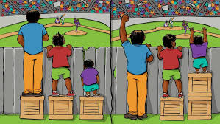
Equality vs. Equity
Equality has to do with giving everyone the exact same resources.
Equity involves distributing resources based on the needs of the recipients.

Slide 5
“Diversity is being invited to the party; inclusion is being asked to dance”
~Verna Myers

Slide 6
Being an “ALLY” is an active role.
If I choose to wear the ALLY badge,
I pledge to:
Demonstrate inclusion.
Be dedicated to self-education and self-awareness.
Be devoted to beginning a growth mindset.
Identify as an individual that is safe and welcoming to all.

Slide 7
CDEI Committee
Formed Fall 2020
Comprised of GFH employee volunteers with multiple different backgrounds, from different departments.
Working to build a culture of acceptance
Working to educate ourselves
Suggested readings
Developing a GFH House wide education plan
Developing a “zero tolerance” policy to address employee and patient situations

Slide 9
Cultural Competency Definition
Cultural competency is action oriented through the capacity to effectively function and generate change. There are seven tenets of cultural competency: learning, acknowledge, awareness, knowledge, engage and integrate, revise and refine, and culturally competent (Gooden & Norman-Major, 2012).

Slide 10
Identity – The “Big 8”
Race
Gender
Age
Ability
Sexual Orientation
Religion
Immigration Status
“The way an individual thinks about themselves, the way they are viewed by the world and the characteristics that define them.”

Slide 11
Activate a growth mindset…

Slide 12
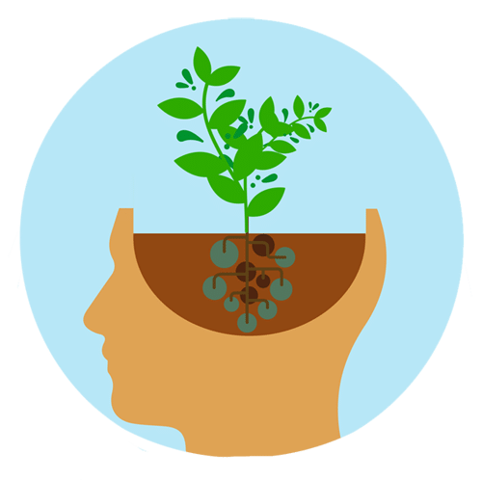
Activate a growth mindset…
Learning and understanding diversity, equity, and inclusion across all populations is a life-long journey.
Through this module we hope to:
Open your mind
Create inquiry
Acknowledge that there is a lot of work to be done
Join together as a GFH Family on this journey
Provide resources

Slide 13
What does it mean to be an ALLY?
“Be compassionate towards yourself and each other.”

Slide 14
Unconscious Bias
“Speaking up is the only way we will make progress.”

Slide 15
Implicit Bias
“Attitude and stereotypes that affect our behaviors, decisions, and attitudes unconsciously.”
“We all have bias.”
“When you have privilege, use your privilege to create equity.”

Slide 16
Implicit Bias
We encourage you to discover your own Implicit Bias via the Harvard website below:
https://implicit.harvard.edu/implicit/takeatest.html
Recommended Tests to Take:
Race
Skin Tone
Sexuality
Religion

Slide 17
AI has Racial and Gender Bias

Slide 18
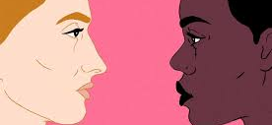
Being “Colorblind”
Stating that you are colorblind can become an issue as you are no longer recognizing the differences that each person may go through. There is nothing wrong with seeing color, the issue comes when you assign different value to the colors that you see.

Slide 19
Microaggression
“You speak really great English!”
“I don't see you as black because you are a professional.”
“Are you going to stop crying and act like a man or are you a sissy girl.”
"I didn't know girls could be the boss.”

Slide 20
Community Partnerships
SUNY Adirondack DEI Committee
Committee for Community Belonging (Southern Adirondack Region)

Slide 21
Bystander Training – the basics
“The bystander effect, or bystander apathy, is a social psychological theory that states that individuals are less likely to offer help to a victim when there are other people present.”

Slide 22
Steps to report issues/observations
Report concerns to your direct manager
Human Resources
CDEI Committee

Slide 23
Vision
At Glens Falls Hospital we are committed to achieving an environment of inclusion and equity that respects, affirms and leverages the backgrounds and life experiences of our workforce and the communities we serve. Across our health care system, we are mindful of all aspects of human differences, such as socioeconomic status, race, ethnicity, language, nationality, sex, gender identity, sexual orientation, religion, geography, disability and age. We recognize that excellence in all aspects of care and service delivery can only be achieved when staff, patients, and residents genuinely connect and engage across cultures to create health equity.
The Committee on Diversity, Equity & Inclusion was established in 2020 to help us achieve this vision.

Slide 24
Mission
Guided by the needs of our patients and our teams, we support efforts to help Glens Falls Hospital deliver equitable health care in a culturally responsive, compassionate way; to improve the health and well-being of the diverse communities we serve; and to educate, engage, and enhance cultural awareness and inclusion across our workforce.

Slide 25
AMC Statement on Diversity
Diversity Definition (updated May 12, 2020)
Diversity means understanding that each individual is unique, and it recognizes and embraces individual differences and abilities. Those differences and abilities can be one, or some of the following: race, ethnicity, gender (including gender identity and expression), sexual orientation, socio-economic status, age, physical abilities, religious beliefs/values, geographic location, ethical values, or other ideologies. Diversity explores such individual differences and abilities in a safe, positive, and nurturing environment. And it involves humans understanding each other and, to the extent that one’s individual conscience permits, moving beyond tolerance to embracing the rich dimensions contained in each person.

Slide 26
Being an “ALLY” is an active role.
If I choose to wear the ALLY badge,
I pledge to:
Demonstrate inclusion.
Be dedicated to self-education and self-awareness.
Be devoted to beginning a growth mindset.
Identify as an individual that is safe and welcoming to all.

Slide 27
To get your Badge Buddy:
Wearing the ALLY Badge Buddy is optional
Complete this module
Print or take a picture of the completion certificate
Bring proof of completion to the Patient Experience Office (located near the West Lobby) the Monday after you finish the education so that we can run a report and verify completion. You can also e-mail proof of completion to patientexperience@glensfallshosp.org.
Wear it proud and spread awareness!

Slide 28
What if someone asks me what the badge means (or if my name is “Ally”)?
This is a great opportunity to share what it means to you to be an ALLY!
For example, you could say: “To be an Ally is to be a safe person for anyone to talk to who feels marginalized or bullied. I’m here for them.”
This is the bare minimum requirement to wear the ALLY badge. We hope you will choose to wear it proudly!

Slide 29
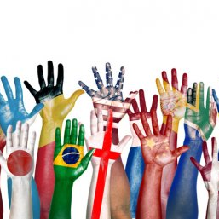
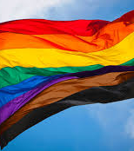
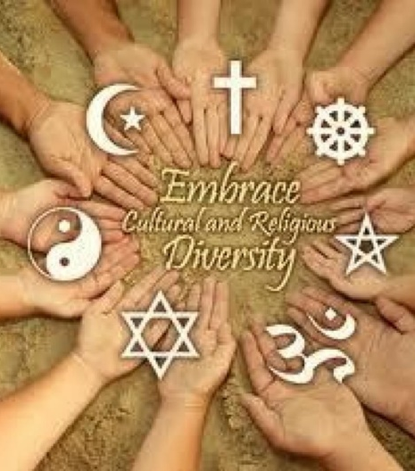
Resources Available - External
LGBTQ National Hotline: 1-888-843-4564
National Suicide Prevention Lifeline : 1-800-273-TALK

Slide 30
Resources Available – Internal GFH
Employee Assistance Program (EAP)
CDEI Committee – email concerns – CDEIconfidential@glensfallshosp.org
Human Resources
Secured drop-box for hand-written concerns/feedback
Located in Tower Lobby near Patient Experience Office

Slide 31
References
Diversity, Equity, and Inclusion (2021). Retrieved from https://dei.extension.org/cultural-competency/
Edwards, F. L., Norman-Major, K. A., & Gooden, S. T. (2012). Cultural competency in disasters. Cultural competency for public administrators, 197-218.
YW Boston Blog, (2020). Your full self: Social Identities and the workplace. Retrieved from https://www.ywboston.org/2020/10/your-full-self-social-identities-and-the-workplace/

